Slide 1
Lecture 12 Hydrogen safety

Slide 2
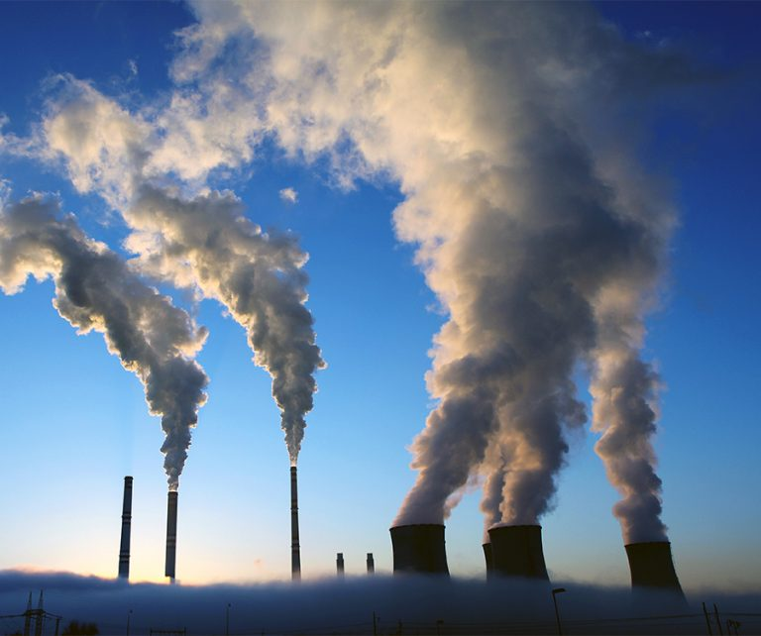
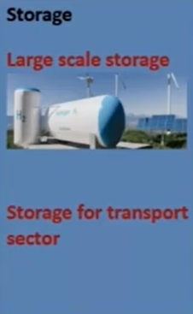

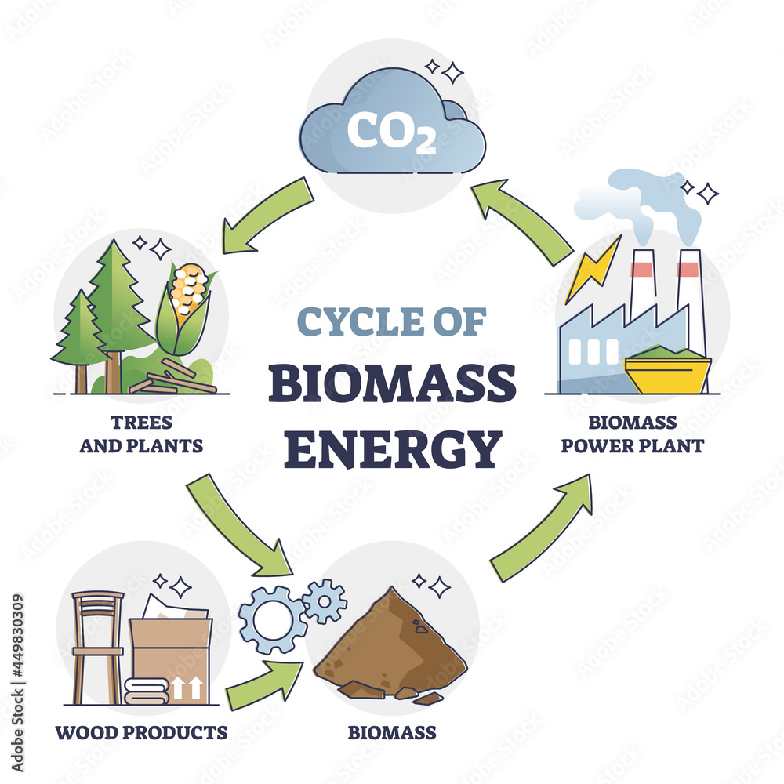
HYDROGEN ECONOMY
Production
Usage
Industrial sector
- Petroleum refinery
- Ammonia plants
- Others (methanol, flat-glass, metal extraction, vegetable
Oils, power plant cooling etc.)
Transport sector
- Fuel Cell Vehicle
- H2 IC Engine vehicle
Distributed power generation
Heating/cooking etc.
Natural Gas
Coal
oil
Solar
Wind
Hydro
Biomass

Slide 3
HYDROGEN ACCIDENTS & SAFETY

Slide 4
HYDROGEN ACCIDENTS AND CAUSALITIES
• First reported accident:
Hindenburg accident, 1937
• Recent accident: 9th Aug, 2021
(Power plant explosion in South
Africa)
• Total reported accidents: 215
• Total death: 124 - 150
• Injury: >900

Slide 5
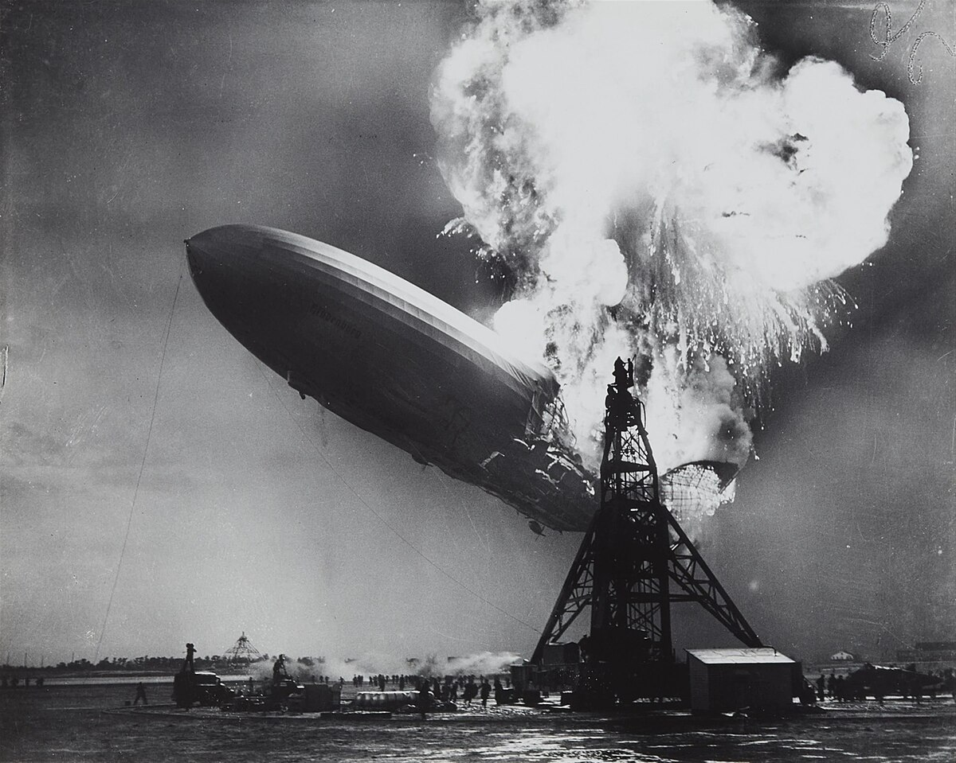
HINDENBURG ACCIDENT (6TH MAY, 1937)
Hindenburg was an airship
It was 245 m long, 41 m in diameter, containing 211,890 m3 of H2 gas, with a useful lift of 112,000 kg, powered by four 820 kW engines giving it a maximum speed of 135 km/h.
Thorough investigation of the accident showed that the outer shell and the paint of the airship, were flammable and could be eventually ignited by electrical sparks.
The airship's outer shell was separated from the aluminum frame by nonconductive ramie cords, thus permitting static electricity accumulation on the shell.

Slide 6
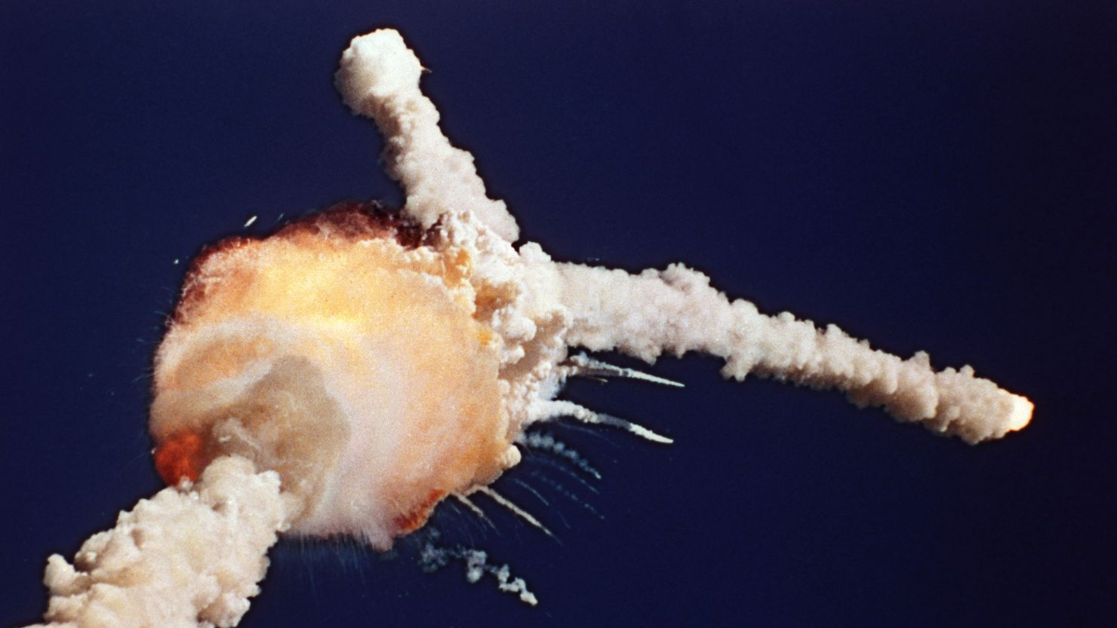
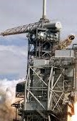

CHALLENGER DISASTER
Space shuttle Challenger was launched on April 12, 1981
73 seconds later the space shuttle was completely destroyed owing to an explosion of the 102 ton capacity LH2 tank (14500 L of H2)
All seven crew members were killed The cause of the explosion was determined to be an O-ring failure.
The unusually cold weather, beyond the tolerances for which the rubber seals were approved, most likely caused the O-ring failure

Slide 7
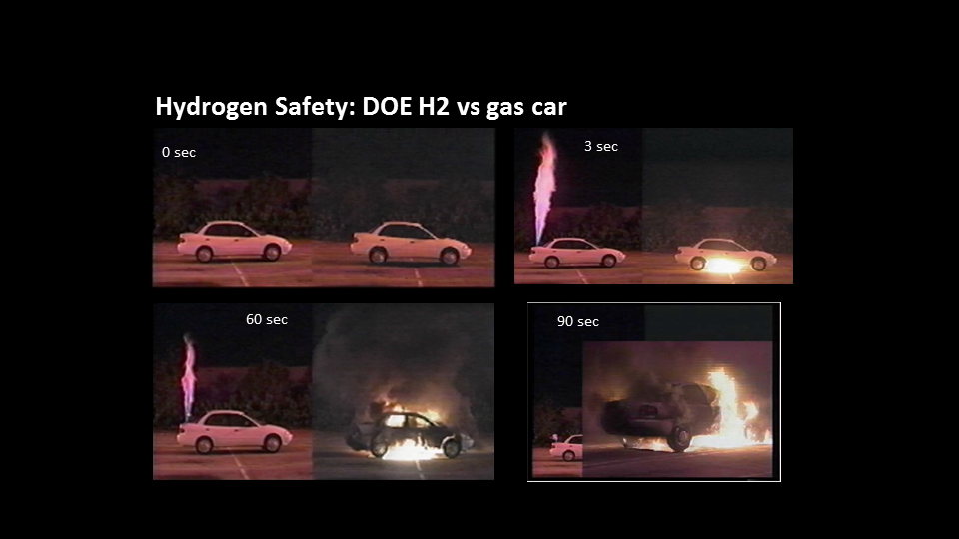
BURNING OF HYDROGEN VS GAS CAR
Source: YouTube, Hydrogen vs. Gasoline Leak and Ignition Test- which is safer?

Slide 8
REGULATORY STRUCTURE FOR H2 TECHNOLOGIES: THE USA CASE
Sandia National Laboratory (Risk-informed setback distances
and materials qualification for H2 service)
National Renewable Energy Laboratory
(Component testing & co- Ordinator)
Los Alamos National Laboratory (Fuel quality testing)
Building
and
Fire codes
Technology specific codes and standards
Component standards
Deployed technology/field Monitoring
Codes and standards
Research and testing/field
Monitoring results
Regulatory Hierarchy

Slide 9
SAFETY GUIDELINES ON HYDROGEN SYSTEMS
Approval of government bodies (India: PESO) after installation of H2 systems
Each building block will be properly distanced
Standard piping/fittings/storage equipment
Regular inspection of hydrogen relief valves
Proper calibration of H2 sensor and alarms
H2 system should be installed outside in open air
Proper ventilation (forced + natural) in case of inside installation
Training and certification on hydrogen safety (US- DOE)
8-16 m

Slide 10
Thank You

